Slide 1
CMS (Credit management system)
Content
OBJECTIVE
HARDWARE & SOFTWARE REQUIREMENTS
USE CASE DIAGRAM
Kanani Jenish (206230307037)
Devang Sharma(206230307054)
ENTITY RELATIONSHIP DIAGRAM
SEQUENCE DIAGRAM
ACTIVITY DIAGRAM
ACTIVITY DIAGRAM COMMISION
DATA FLOW DIAGRAM

Slide 2
CMS (Credit management system)
Content
OBJECTIVE
HARDWARE & SOFTWARE REQUIREMENTS
USE CASE DIAGRAM
ENTITY RELATIONSHIP DIAGRAM
The objective of this application is to go with a computerized system that manages the details about money lend by Credit Lender, and it helps users need not to worry about any detail about it.
This system enables the user to take money from a private credit lender in a very smooth, difficult less and easy operations.
SEQUENCE DIAGRAM
ACTIVITY DIAGRAM
Kanani Jenish (206230307037)
Devang Sharma(206230307054)
ACTIVITY DIAGRAM COMMISION
DATA FLOW DIAGRAM

Slide 3
CMS (Credit management system)
Content
OBJECTIVE
The objective of this application is to go with a computerized system that manages the details about money lend by Credit Lender, and it helps users need not to worry about any detail about it.
This system enables the user to take money from a private credit lender in a very smooth, difficult less and easy operations.
HARDWARE & SOFTWARE REQUIREMENTS
USE CASE DIAGRAM
Kanani Jenish (206230307037)
Devang Sharma(206230307054)
ENTITY RELATIONSHIP DIAGRAM
SEQUENCE DIAGRAM
ACTIVITY DIAGRAM
ACTIVITY DIAGRAM COMMISION

Slide 4
CMS (Credit management system)
Content
OBJECTIVE
HARDWARE & SOFTWARE REQUIREMENTS
USE CASE DIAGRAM
Minimum Hardware: -RAM : 2 GB
-CPU : Intel i3 (Gen 7)
-Storage : Around (400 MB)
Recommended Hardware: RAM : 8 GB
CPU : Intel i3 (Gen 9 or above)
Storage : 1 GB
Recommended OS: Windows 10 or above
ENTITY RELATIONSHIP DIAGRAM
The objective of this application is to go with a computerized system that manages the details about money lend by Credit Lender, and it helps users need not to worry about any detail about it.
This system enables the user to take money from a private credit lender in a very smooth, difficult less and easy operations.
SEQUENCE DIAGRAM
ACTIVITY DIAGRAM
Kanani Jenish (206230307037)
Devang Sharma(206230307054)
ACTIVITY DIAGRAM COMMISION
DATA FLOW DIAGRAM

Slide 5
CMS (Credit management system)
Content
HARDWARE & SOFTWARE REQUIREMENTS
OBJECTIVE
Minimum Hardware: -RAM : 2 GB
-CPU : Intel i3 (Gen 7)
-Storage : Around (400 MB)
Recommended Hardware: RAM : 8 GB
CPU : Intel i3 (Gen 9 or above)
Storage : 1 GB
Recommended OS: Windows 10 or above
The objective of this application is to go with a computerized system that manages the details about money lend by Credit Lender, and it helps users need not to worry about any detail about it.
This system enables the user to take money from a private credit lender in a very smooth, difficult less and easy operations.
USE CASE DIAGRAM
Kanani Jenish (206230307037)
Devang Sharma(206230307054)
ENTITY RELATIONSHIP DIAGRAM
SEQUENCE DIAGRAM
ACTIVITY DIAGRAM
ACTIVITY DIAGRAM COMMISION

Slide 6
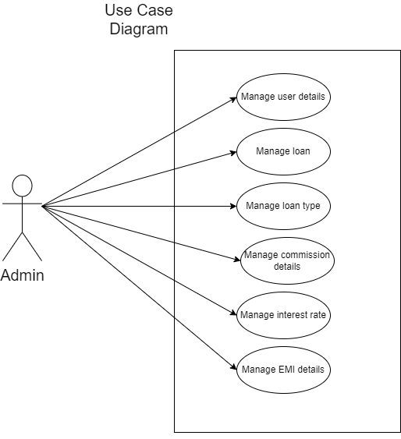
CMS (Credit management system)
Content
OBJECTIVE
HARDWARE & SOFTWARE REQUIREMENTS
USE CASE DIAGRAM
ENTITY RELATIONSHIP DIAGRAM
The objective of this application is to go with a computerized system that manages the details about money lend by Credit Lender, and it helps users need not to worry about any detail about it.
This system enables the user to take money from a private credit lender in a very smooth, difficult less and easy operations.
SEQUENCE DIAGRAM
ACTIVITY DIAGRAM
Kanani Jenish (206230307037)
Devang Sharma(206230307054)
ACTIVITY DIAGRAM COMMISION
DATA FLOW DIAGRAM

Slide 7
CMS (Credit management system)
Content
USE CASE DIAGRAM
OBJECTIVE
HARDWARE & SOFTWARE REQUIREMENTS
ENTITY RELATIONSHIP DIAGRAM
SEQUENCE DIAGRAM
ACTIVITY DIAGRAM
ACTIVITY DIAGRAM COMMISION

Slide 8
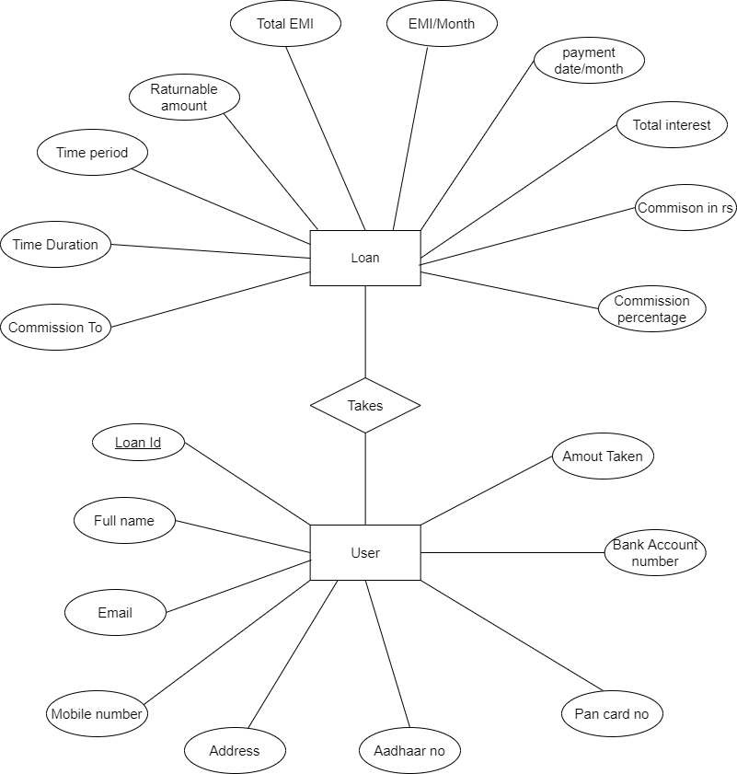
CMS (Credit management system)
Content
OBJECTIVE
HARDWARE & SOFTWARE REQUIREMENTS
USE CASE DIAGRAM
ENTITY RELATIONSHIP DIAGRAM
The objective of this application is to go with a computerized system that manages the details about money lend by Credit Lender, and it helps users need not to worry about any detail about it.
This system enables the user to take money from a private credit lender in a very smooth, difficult less and easy operations.
SEQUENCE DIAGRAM
ACTIVITY DIAGRAM
Kanani Jenish (206230307037)
Devang Sharma(206230307054)
ACTIVITY DIAGRAM COMMISION
DATA FLOW DIAGRAM

Slide 9
Content
ENTITY RELATIONSHIP DIAGRAM
OBJECTIVE
HARDWARE & SOFTWARE REQUIREMENTS
USE CASE DIAGRAM
SEQUENCE DIAGRAM
ACTIVITY DIAGRAM
ACTIVITY DIAGRAM COMMISION
CMS (Credit management system)

Slide 10
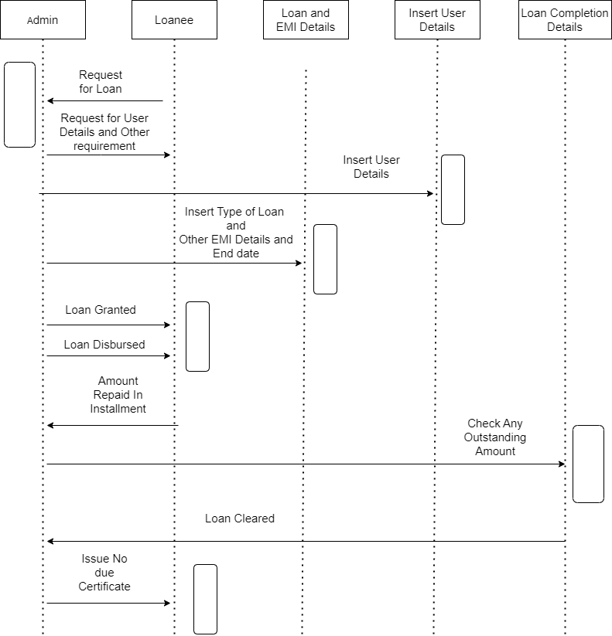
CMS (Credit management system)
Content
OBJECTIVE
HARDWARE & SOFTWARE REQUIREMENTS
USE CASE DIAGRAM
ENTITY RELATIONSHIP DIAGRAM
The objective of this application is to go with a computerized system that manages the details about money lend by Credit Lender, and it helps users need not to worry about any detail about it.
This system enables the user to take money from a private credit lender in a very smooth, difficult less and easy operations.
SEQUENCE DIAGRAM
ACTIVITY DIAGRAM
Kanani Jenish (206230307037)
Devang Sharma(206230307054)
ACTIVITY DIAGRAM COMMISION
DATA FLOW DIAGRAM

Slide 11
Content
SEQUENCE DIAGRAM
OBJECTIVE
HARDWARE & SOFTWARE REQUIREMENTS
USE CASE DIAGRAM
ENTITY RELATIONSHIP DIAGRAM
ACTIVITY DIAGRAM
ACTIVITY DIAGRAM COMMISION
CMS (Credit management system)

Slide 12
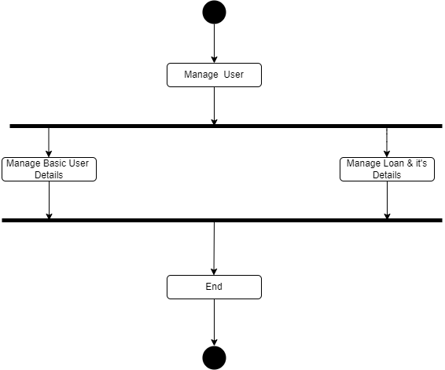
CMS (Credit management system)
Content
OBJECTIVE
HARDWARE & SOFTWARE REQUIREMENTS
USE CASE DIAGRAM
ENTITY RELATIONSHIP DIAGRAM
The objective of this application is to go with a computerized system that manages the details about money lend by Credit Lender, and it helps users need not to worry about any detail about it.
This system enables the user to take money from a private credit lender in a very smooth, difficult less and easy operations.
SEQUENCE DIAGRAM
ACTIVITY DIAGRAM
Kanani Jenish (206230307037)
Devang Sharma(206230307054)
ACTIVITY DIAGRAM COMMISION
DATA FLOW DIAGRAM

Slide 13
Content
ACTIVITY DIAGRAM
OBJECTIVE
HARDWARE & SOFTWARE REQUIREMENTS
USE CASE DIAGRAM
ENTITY RELATIONSHIP DIAGRAM
SEQUENCE DIAGRAM
ACTIVITY DIAGRAM COMMISION
CMS (Credit management system)

Slide 14
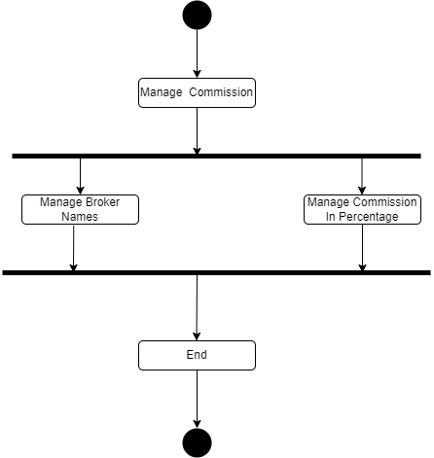
CMS (Credit management system)
Content
OBJECTIVE
HARDWARE & SOFTWARE REQUIREMENTS
USE CASE DIAGRAM
ENTITY RELATIONSHIP DIAGRAM
The objective of this application is to go with a computerized system that manages the details about money lend by Credit Lender, and it helps users need not to worry about any detail about it.
This system enables the user to take money from a private credit lender in a very smooth, difficult less and easy operations.
SEQUENCE DIAGRAM
ACTIVITY DIAGRAM
Kanani Jenish (206230307037)
Devang Sharma(206230307054)
ACTIVITY DIAGRAM COMMISION
DATA FLOW DIAGRAM

Slide 15
Content
ACTIVITY DIAGRAM COMMISION
OBJECTIVE
HARDWARE & SOFTWARE REQUIREMENTS
USE CASE DIAGRAM
ENTITY RELATIONSHIP DIAGRAM
SEQUENCE DIAGRAM
ACTIVITY DIAGRAM
ACTIVITY DIAGRAM COMMISION
CMS (Credit management system)

Slide 16
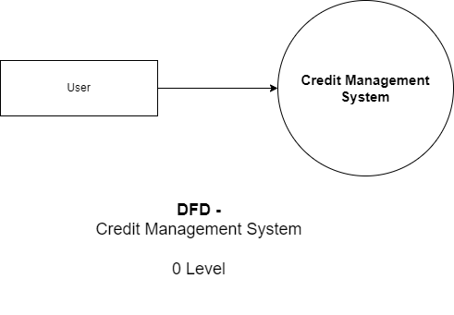
CMS (Credit management system)
Content
OBJECTIVE
HARDWARE & SOFTWARE REQUIREMENTS
USE CASE DIAGRAM
ENTITY RELATIONSHIP DIAGRAM
The objective of this application is to go with a computerized system that manages the details about money lend by Credit Lender, and it helps users need not to worry about any detail about it.
This system enables the user to take money from a private credit lender in a very smooth, difficult less and easy operations.
SEQUENCE DIAGRAM
ACTIVITY DIAGRAM
Kanani Jenish (206230307037)
Devang Sharma(206230307054)
ACTIVITY DIAGRAM COMMISION
DATA FLOW DIAGRAM

Slide 17
Content
DATA FLOW DIAGRAM
OBJECTIVE
HARDWARE & SOFTWARE REQUIREMENTS
USE CASE DIAGRAM
ENTITY RELATIONSHIP DIAGRAM
SEQUENCE DIAGRAM
ACTIVITY DIAGRAM
ACTIVITY DIAGRAM COMMISION
CMS (Credit management system)

Slide 18
CMS (Credit management system)
Content
OBJECTIVE
HARDWARE & SOFTWARE REQUIREMENTS
USE CASE DIAGRAM
ENTITY RELATIONSHIP DIAGRAM
The objective of this application is to go with a computerized system that manages the details about money lend by Credit Lender, and it helps users need not to worry about any detail about it.
This system enables the user to take money from a private credit lender in a very smooth, difficult less and easy operations.
SEQUENCE DIAGRAM
ACTIVITY DIAGRAM
Kanani Jenish (206230307037)
Devang Sharma(206230307054)
ACTIVITY DIAGRAM COMMISION
DATA FLOW DIAGRAM

Slide 19
CMS (Credit management system)
Content
OBJECTIVE
HARDWARE & SOFTWARE REQUIREMENTS
USE CASE DIAGRAM
Kanani Jenish (206230307037)
Devang Sharma(206230307054)
ENTITY RELATIONSHIP DIAGRAM
SEQUENCE DIAGRAM
ACTIVITY DIAGRAM
ACTIVITY DIAGRAM COMMISION
DATA FLOW DIAGRAM

